Slide 1


Slide 2

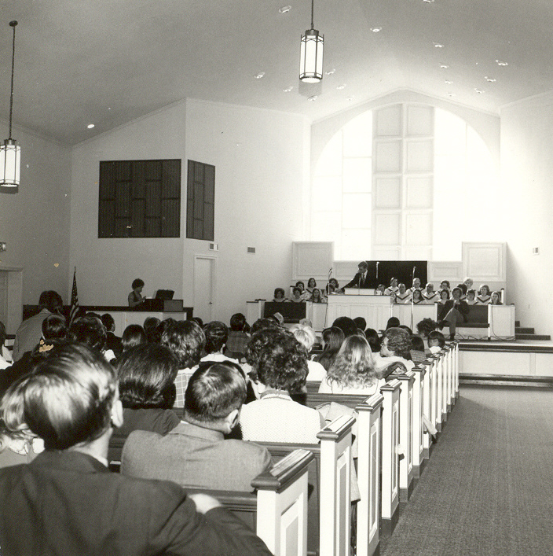
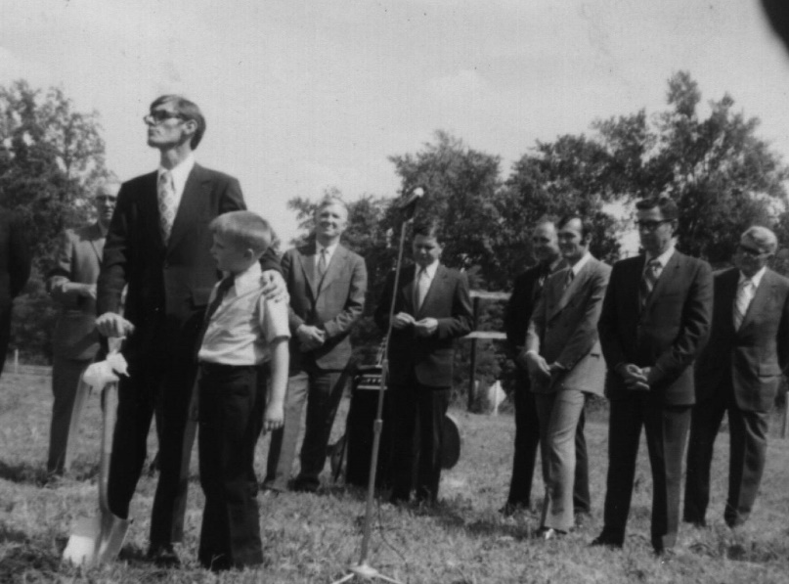


Slide 3
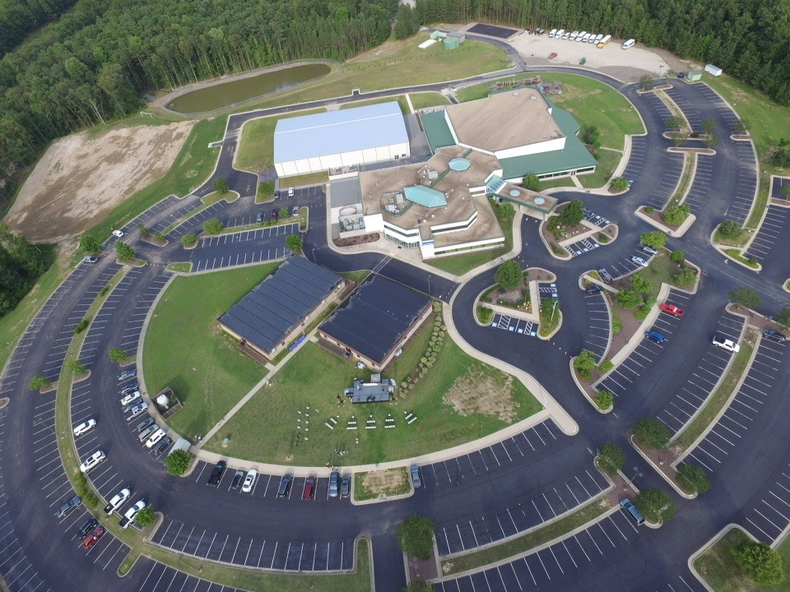
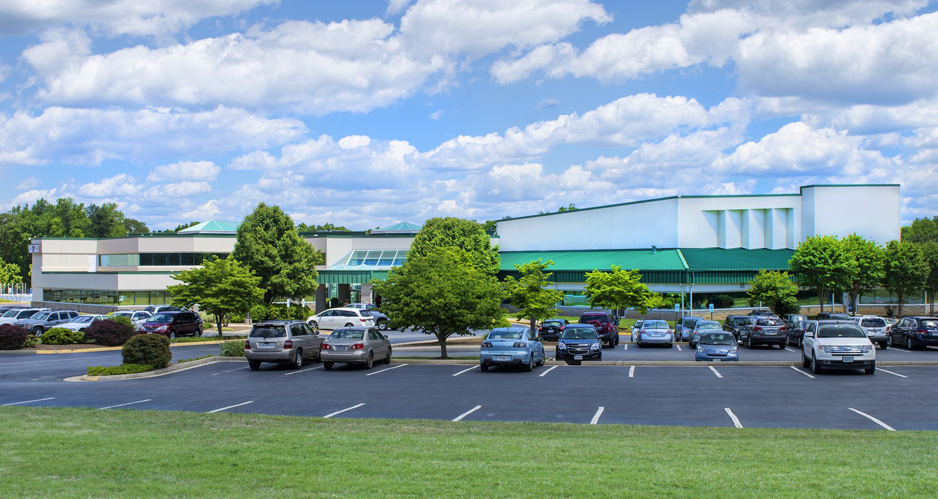

Slide 4







Slide 5
  As a prisoner for the Lord,
  then, I urge you to live a life worthy
  of the calling you have received.
  Ephesians 4:1 NIV

Slide 6
  We must live lives of faithful obedience
  in a consistent direction!

Slide 7
  Be completely humble
  Ephesians 4:2 NIV

Slide 8
  Be completely humble and gentle
  Ephesians 4:2 NIV

Slide 9
  Be completely humble and gentle;
  be patient
  Ephesians 4:2 NIV

Slide 10
  Be completely humble and gentle;
  be patient, bearing with one another in love
  Ephesians 4:2 NIV

Slide 11
  Make every effort to keep the unity of the
  Spirit through the bond of peace.
  Ephesians 4:3 NIV

Slide 12
  We are called to bring our unique
  perspectives into unity with others
  as we pull together and impact
  our world for Jesus!

Slide 13
  Excellence breeds a desire to connect,
  and the deeper the connections
  the more the power of Jesus
  can be revealed in our lives!

Slide 14


